Slide 1
Model Building (9-dars)
Davronbek Malikov

Slide 2
Vazifa
Classga oid misollar ishlang
O’rganilgan tushunchalar ro’yhati
Tezkor project(Classdan foydalangan xolda)

Slide 3
Bugun
Savol javob
Model Improvement nima?
Model Imrovement yo’llari
Transform features
Vazifa

Slide 4
Takrorlash

Slide 5
Takrorlash
Savol javob
Qo’shimcha dars(idea)
Feature Engineering Review
Feature Engineering:Techniques
Class in Data Preprocessing
Vazifa

Slide 6
Model Imrovement

Slide 7
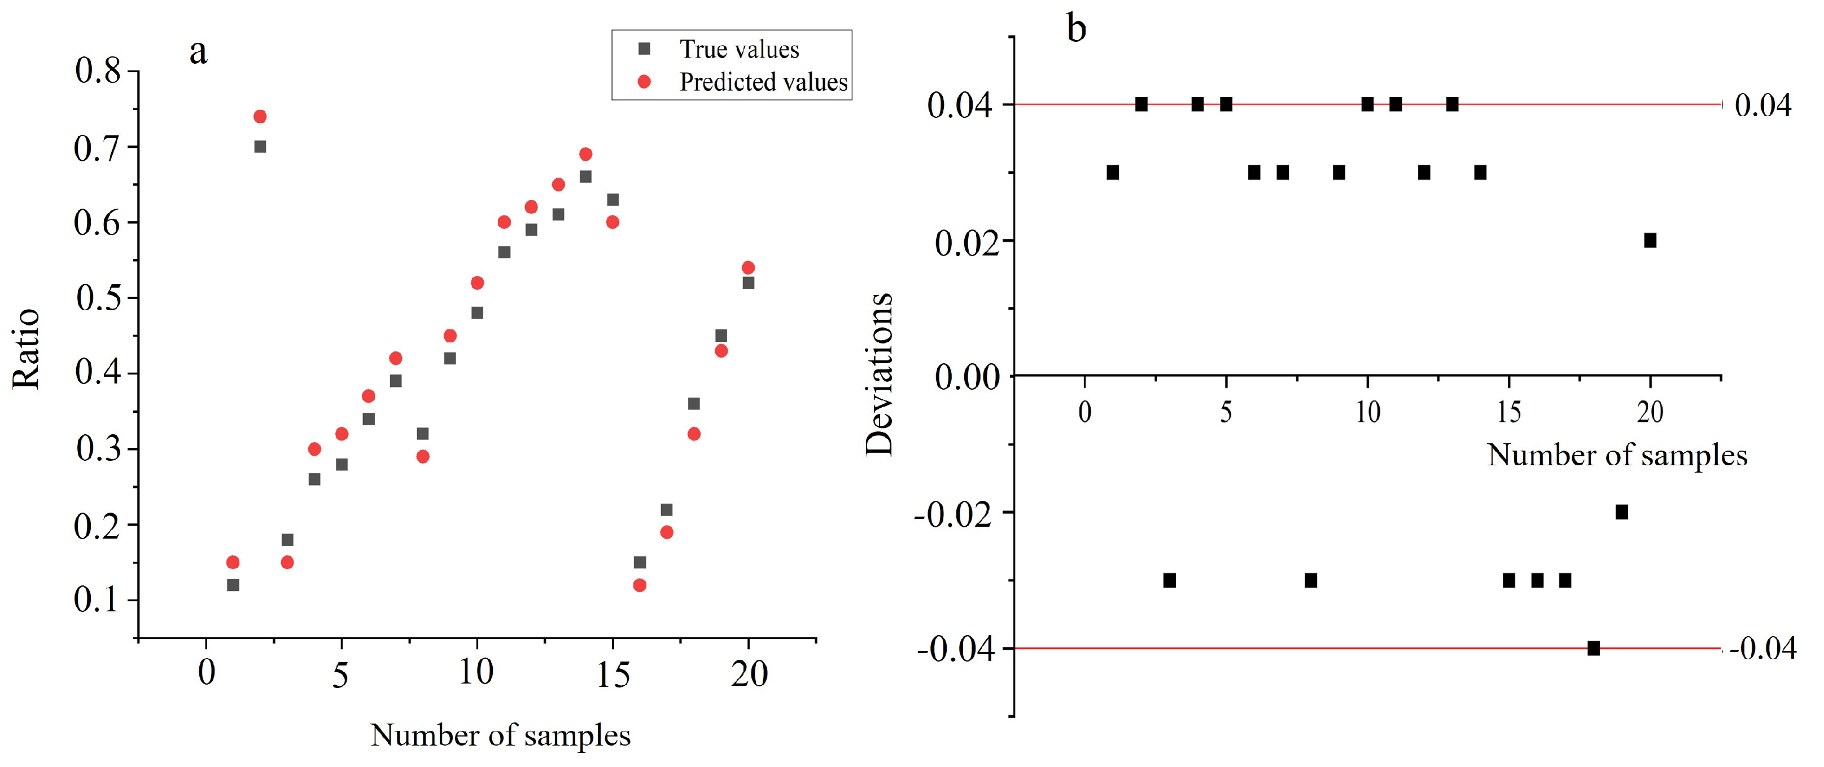
Model Improvement
Model Prediction qiymatini xaqiqiy qiymatga yaqinlashtirish

Slide 8
Model Improvement
Regression
Reducing Error(mse, mae)
Increasing r2
Classification
Increasing accuracy score

Slide 9
Model Imrovement yo’llari

Slide 10
Model Imrovement yo’llari
Data Quality and Quantaty
Ko’proq dataset collection
Datasetni tozalang
Feature Engineering
Yangi Featurelar yarating
Transform features
Domain knowledge
Feature Selection
Scaling
Turli xil algorithmlar bn tekshiri
Bazi xollarda sodaroq algorithmlar xam yuqori natija beradi
Hyperparametr tuning
Bizning algorithm va datasetga mos paramaterlarni topish jarayoni
Cross validation
Regulararization
Ensemble Methods
Handling Imbanced Dataset (Classification)

Slide 11
Model Imrovement yo’llari
Yaxshi model= Yaxshi dataset+ Aqqli va foydali features+to’g’ri algorithmlar+tuning+ overfittingni oldini olish

Slide 12
Transform features

Slide 13
Transform features
Input featurelarni ML algorithmlar uchun moslashtirish jarayoni
Yani featurelarni kompyuterga osonroq tilda tushuntirish
Qisqacha: Featurelarni o’zgartirish

Slide 14
Transform features: Turlari
Feature Scaling
Log Transformation
Power Transformation
Polynomial Features
Encoding

Slide 15
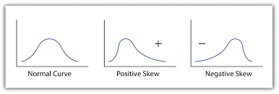
Transform features: Log Transformation
Skewness(qiyshayish)
Matametikal transformation
Faqatgina musbat qiymatlarda ishlaydi(manfiy bolsa barcha qiymatlarga c=constant qiymat qo’shing)
Asosan Positive skewnesslik xolatlarda ishlaydi va maqsad qiymatlarni normallashtirish
Tree- based algorithlarda bazi xolatlarda foydasi va keraksiz

Slide 16
Transform features: Log Transformation
Skewness(qiyshayish)
Matametikal transformation
Faqatgina musbat qiymatlarda ishlaydi(manfiy bolsa barcha qiymatlarga c=constant qiymat qo’shing)
Asosan Positive skewnesslik xolatlarda ishlaydi va maqsad qiymatlarni normallashtirish

Slide 17
Vazifa

Slide 18
Vazifa
Class va funksiyani takrorlang
Projectga log tramsformni xam tadbiq qiling
Boshqa kichik bir loyihada logsiz va logli+feature engineering xolatda compare qiling

